Slide 1
Generative Models for SciVis
team: TYTSSN
Jingyi Shen, Haoyu Li, Neng Shi

Slide 2
Volumetric Isosurface Rendering with Deep Learning-Based Super-Resolution
Sebastian Weiss , Mengyu Chu, Nils Thuerey and Rüdiger Westermann
Technical University of Munich

Slide 3
Related work
Deep learning for Scientific visualization
representing raw data output as images
topic: Generative models used in scientific visualization
Notes:
Scientific visualization is the process of quickly and effectively representing raw data output as images; aid in understanding the meaning of the scientific data
This involves research in computer graphics, image processing, high performance computing, and other areas. T
A common example of scientific visualization is the combination of atmospheric data with color, placement, illumination, and texture for use in television weather programs.

Slide 4
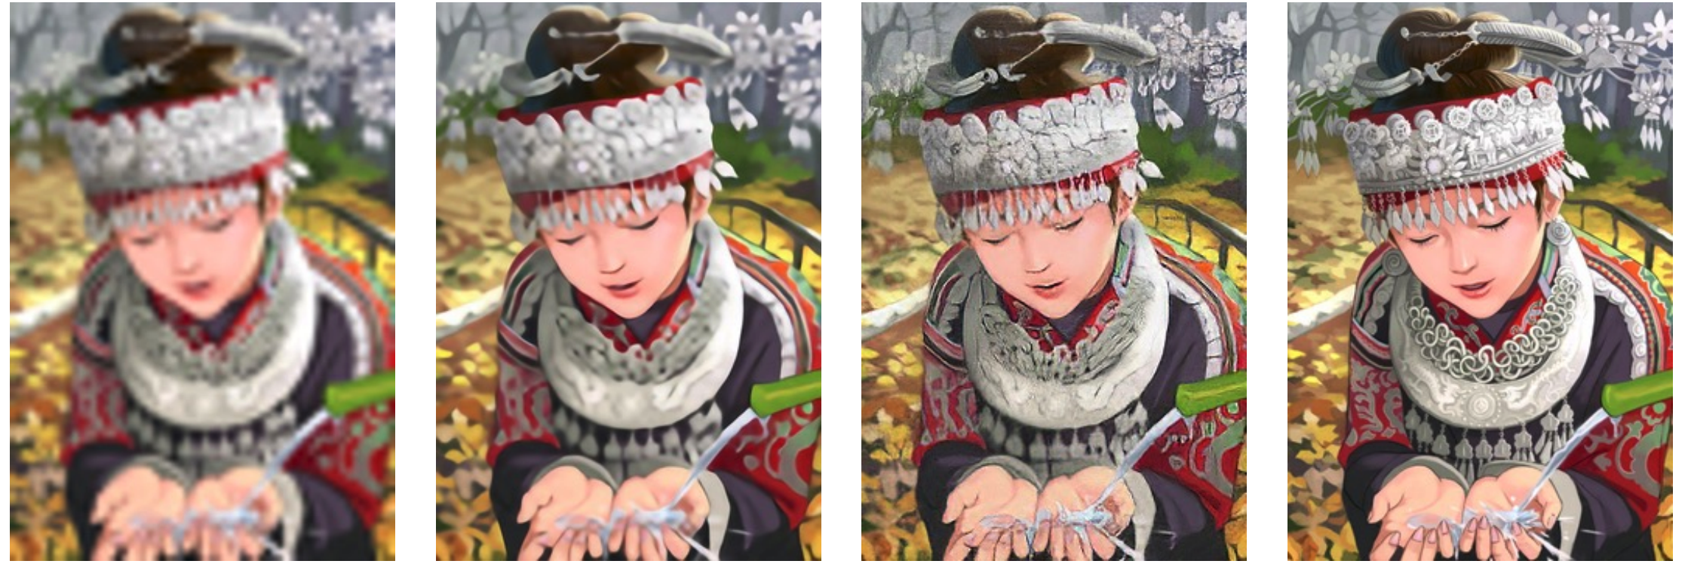
Related work
Generative models
estimates the joint probability distribution of data P(X, Y)
(Naive Bayesian, Markov chain, VAE, GAN, etc.)
Why Generative models?
Super-resolution
deep residual generative adversarial network
C. Ledig, L. Theis, F. Huszar, J. Caballero, A. Cunningham, ´ A. Acosta, A. Aitken, A. Tejani, J. Totz, Z. Wang, et al. Photo-realistic single image super-resolution using a generative adversarial network.
bicubic interpolation
deep residual network optimized for MSE
original HR image
Fig 1: Super-resolution
Notes:
Given an observable variable X and a target variable Y, a generative model is a statistical model of the joint probability distribution on X × Y,
P(X,Y)
SR received substantial attention in CV research community， more detailed and realistic
from left to right: bicubic interpolation, deep residual network optimized for MSE, deep residual generative adversarial network optimized for a loss more sensitive to human perception, original HR image
with residual strategy → surpass bi-inter.

Slide 5
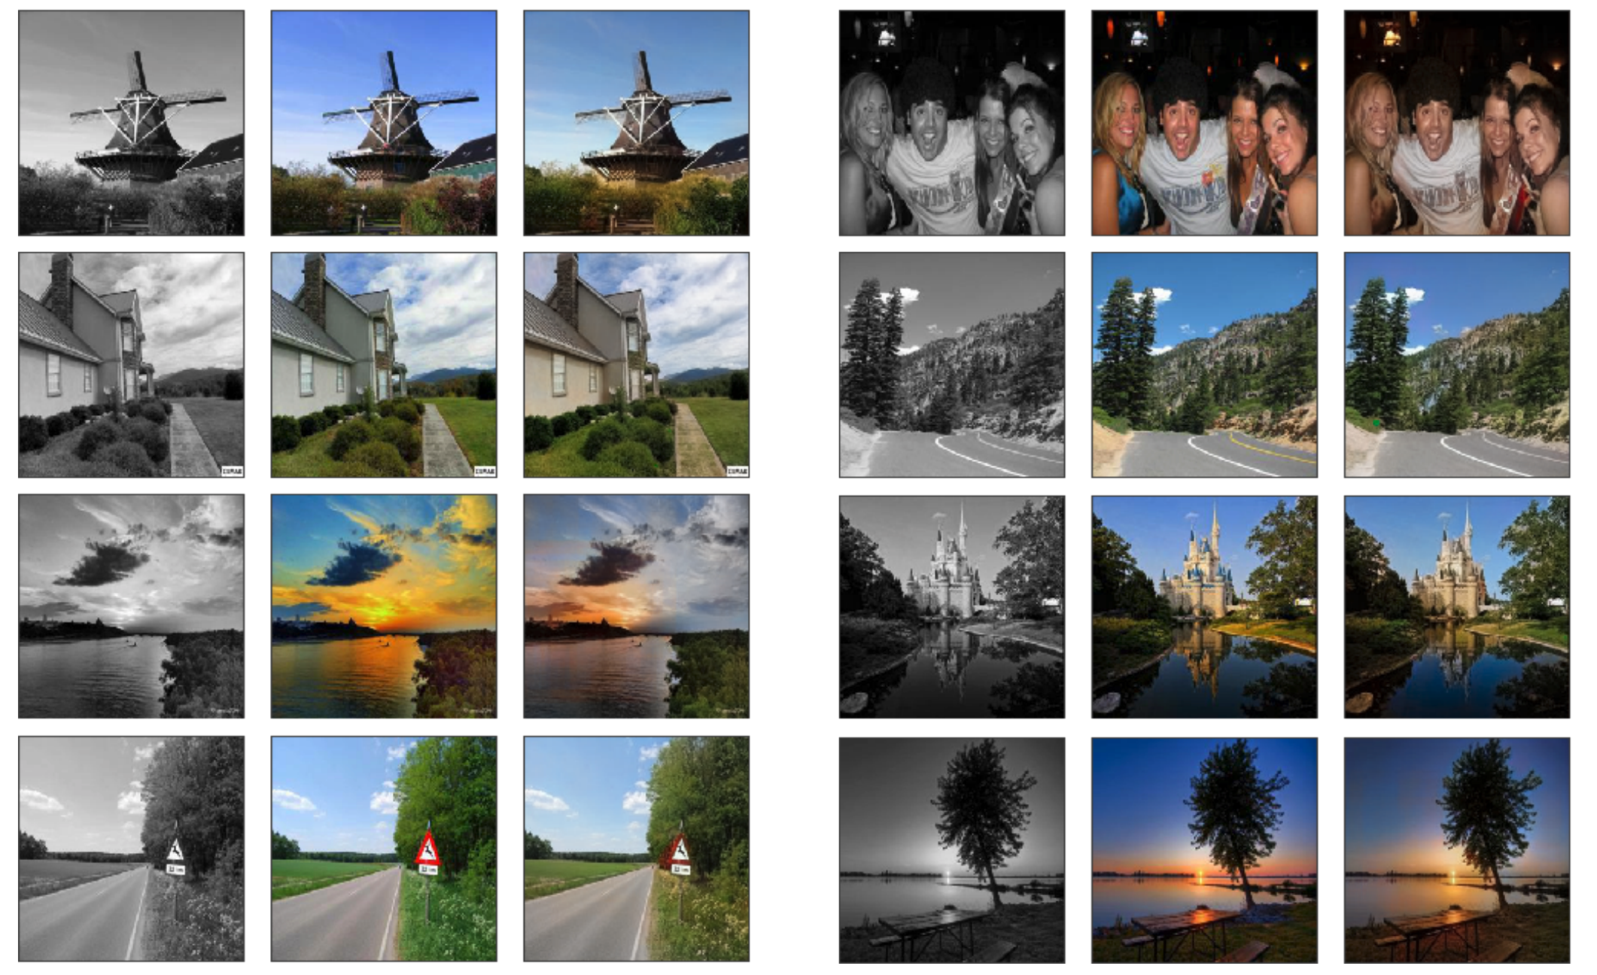
Related work
Generative models
estimates the joint probability distribution of data P(X, Y)
(Naive Bayesian, Markov chain, VAE, GAN, etc.)
Why Generative models?
Super-resolution
Colorization
Kamyar Nazeri, Eric Ng, and Mehran Ebrahimi. Image colorization using generative adversarial networks. In International Conference on Articulated Motion and Deformable Objects, pages 85–94. Springer, 2018
Fig 2: Colorization
Notes:
Colorization results with Places365 (a) Grayscale. (b) Original Image. (c) Colorized with GAN
Deep Convolutional Generative Adversarial Network (DCGAN).

Slide 6
Related work
Generative models
estimates the joint probability distribution of data P(X, Y)
(Naive Bayesian, Markov chain, VAE, GAN, etc.)
Why Generative models?
Super-resolution
Colorization
Simulation
Generate latent representations (can be used as features)
Notes:
apply generative models on time-series data → Simulation

Slide 7
Related work
Generative models used in scientific visualization
Generative Adversarial Network (GAN):
Volume Rendering
spatial super-resolution
from parameter space to image
Recurrent Generative Network (RGN):
temporal super-resolution of time-varying data

Slide 8
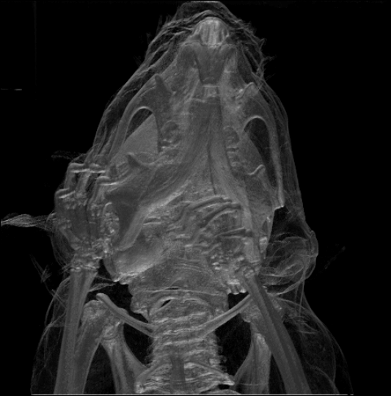
Scientific visualization with deep learning
Volume rendering
display a 2D projection of a 3D discretely sampled data set, typically a 3D scalar field
obtain overviews, identify distinct features, and discover interesting patterns
a computationally intensive task
traditional methods
a volumetric scalar field
a viewpoint
transfer functions (TFs) (for opacity and color)
Fig 3: Example of a mouse skull (CT) rendering
Credit: Christian Lackas <delta@lackas.net>
Notes:
vis volumetric data?
Volume rendering (an important part of modern scientific visualization), offers a tool to interactively explore scalar fields,
it can be used to obtain overviews, identify distinct features, and discover interesting patterns.
For example, a volume may be viewed by extracting isosurfaces (surfaces of equal values) from the volume and rendering them as polygonal meshes or by rendering the volume directly as a block of data.
given a volumetric scalar field, a viewpoint, and (TFs) for opacity and color, it generates an image via the volume rendering integral [1], which controls the accumulation of color contributions along a ray at each pixel.

Slide 9
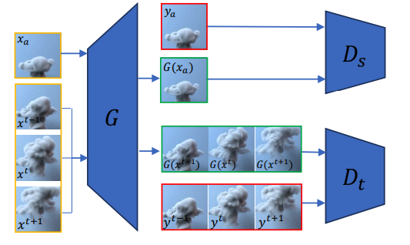
Related work
tempoGAN: A Temporally Coherent, Volumetric GAN for Super-resolution Fluid Flow{http://arxiv.org/abs/1801.09710}
Goal: generate high-resolution volumetric data sets of advected flow quantities, and ensuring temporal coherence
Method:
a novel temporal discriminator (D_{t}) to generate consistent and highly detailed results over time
add a negative feature loss to encourage the generalizability, give artistic control of outputs
add additional physical quantities (e.g., velocity) as inputs, improves convergence and quality of the inferred results
high-res (ground truth)
low-res
high-res
Fig 2: a high level overview of the approach
Notes:
apply a standard GAN structure on volumetric smoke data
x: low-res density field, y: GT
a generator (G) is guided during training by two discriminator networks (Ds and Dt), one of which focuses on space (Ds ), while the other one focuses on temporal aspects (Dt ).
They need some coherence bwt the adj generated frames.
3 adjacent low-res density field to G, ONE BY ONE.
(advect there frames with velocity field → warp operation, previous frame forward and next frame backward→ frames are better aligned)
temporal discriminator: Dt will learn how much difference is desired in GT, driving G(x) towards solutions that match the temporal evolution of the ground-truth y; trained on a sequence of frames
-feat loss: more high-freq details
input: density, velocity (potential relationship bwt the low-res density, high-res density and velocity, vorticity)
upscale X4; nine days long 3d training time

Slide 10
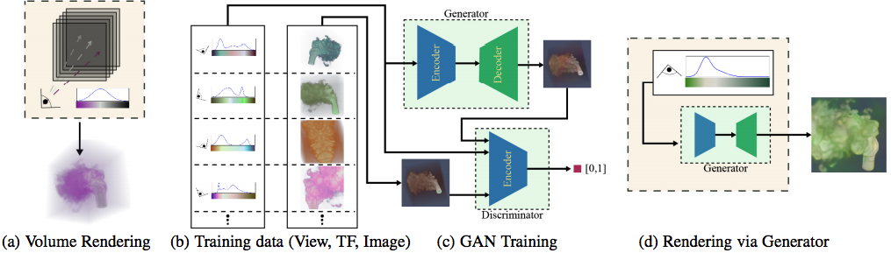
Related work
A Generative Model for Volume Rendering{http://arxiv.org/abs/1710.09545}
Goal:
Idea: take volume rendering as training a deep generative model to synthesize images, conditioned on viewpoint and transfer function(TF)
Method: analysis-by-synthesis
provide an overview of captured volumetric features
guide the user in editing the transfer function for further discovery of data
Fig 3.
Notes:
transfer functions (TFs) convert data value to opacity and color
A user traditionally interacts with a volume renderer by modifying the TF in order to adjust optical properties in the rendered image. In a user’s workflow it is important to have tools that provide an overview of volumetric features captured by transfer function and renderer
represent VR as a generative model
measure the sensitive of user edits and TF design; explore latent space of TFs
in their result, user can change the view point, manipulate the TFto discover the features of a volume.
GAN
proven effective for representing complex data distributions.
In this case, the data distribution is the space of possible images produced by rendering a single volume dataset, given a space of viewpoints and TFs (both color and opacity). trains a model by learning a mapping from parameters to image
(a)Volume rendering traditionally takes as input the volume, viewpoint, and transfer function, and evaluates the volume rendering integral to produce an image.
(b)interpret volume rendering as a process that takes viewpoint and transfer function, and produces the corresponding volume-rendered image.
input: a large set of volume-rendered images and visualization parameters
(c)learn a GAN that generates an opacity image conditioned on a view and opacity transfer function
(d)conditioned on this opacity image, The trained model synthesizes images from novel viewpoints and TFs
the generative model transforms transfer functions and viewpoint into latent space (designed to synthesize volume-rendered images)
use this latent space directly for rendering, enabling the user to explore the space of volume-rendered images

Slide 11
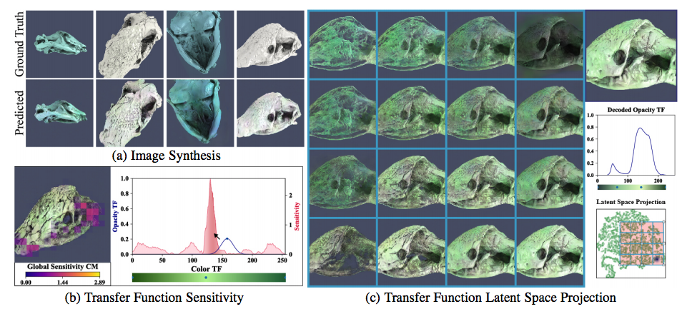
Related work
A Generative Model for Volume Rendering{http://arxiv.org/abs/1710.09545}
Idea: take volume rendering as training a deep generative model to synthesize images, conditioned on viewpoint and transfer function(TF)
Fig 4.
Notes:
the paper cast volume rendering as training a deep generative model to synthesize images, conditioned on viewpoint and transfer function.
(a)images synthesized with the model, compared to a ground truth volume renderer.
(b)the transfer function (blue curve) augmented by a sensitivity function (red curve) that quantifies expected image change, guiding the user to edit regions of the transfer function
(c)the projection of a learned transfer function latent space that enables the user to explore the space of transfer functions.

Slide 12
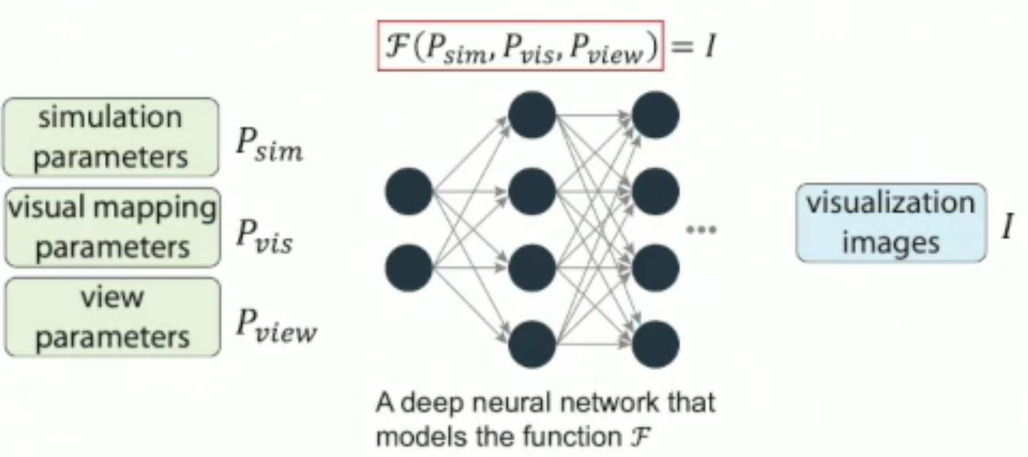
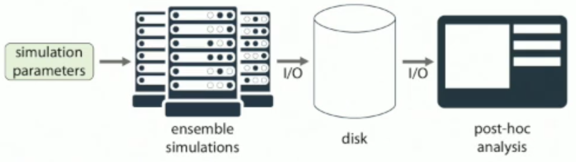
Related work
InSituNet: Deep Image Synthesis for Parameter Space Exploration of Ensemble Simulations
Goal:
study how the parameters influence the visualization results
predict simulation results for new parameter settings
Fig 5
Fig 6: Deep learning solution
Notes:
to model complex scientific phenomena, scientists need to try diff simulation parameters with diff sim parameters, get ensemble simulations and store on disk for post-hoc analysis
size of data continuous to grow; issue arise: such as IO bottleneck and storage overhead
on approach is in situ vis: generate imgs at simulation time and only store images for post-hoc analysis. (challenges: limit flexibility of post-hoc analysis because the raw simulation data are no longer available, challenging the new para settings)
A deep image synthesis model (i.e., InSituNet)

Slide 13
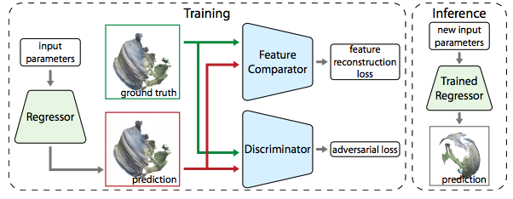
Related work
InSituNet: Deep Image Synthesis for Parameter Space Exploration of Ensemble Simulations
Goal:
Method: feature reconstruction loss + adversarial loss
force the regressor to generate imgs sharing similar features with ground truth
study how the parameters influence the visualization results
predict simulation results for new parameter settings
Fig 7
Notes:
input: parameters; output: prediction images; update the weights of regressor during training
generate imgs at simulation time and only store images. (challenges: limit flexibility of post-hoc analysis, challenging the new para settings
feature comparator: (pre-trained model)VGG-19, MSE between the prediction and ground truth images; force the regressor to generate images sharing the similar features with the ground truth, leads to images with sharper features
discrimitor: trained to differentiate the prediction (fake) and ground truth (real) images
input: real/fake images and the input parameters
output likelihood, how likely the image is a real or fake

Slide 14
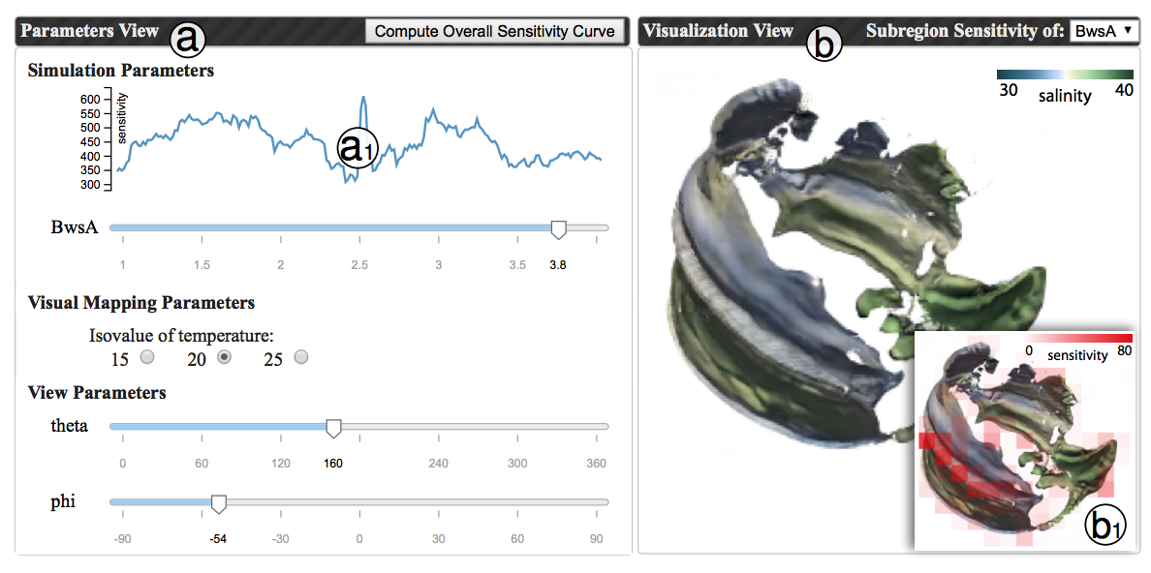
Related work
InSituNet: Deep Image Synthesis for Parameter Space Exploration of Ensemble Simulations
Goal:
Result:
study how the parameters influence the visualization results
predict simulation results for new parameter settings
predict images from new parameter settings
compute the sensitivity of parameters
Fig 8. Visual interface for parameter space exploration.
Notes:
dark red area: more sensitive to current parameter
DL based image synthesis model for parameter space exploration of large scale ensemble simulations

Slide 15
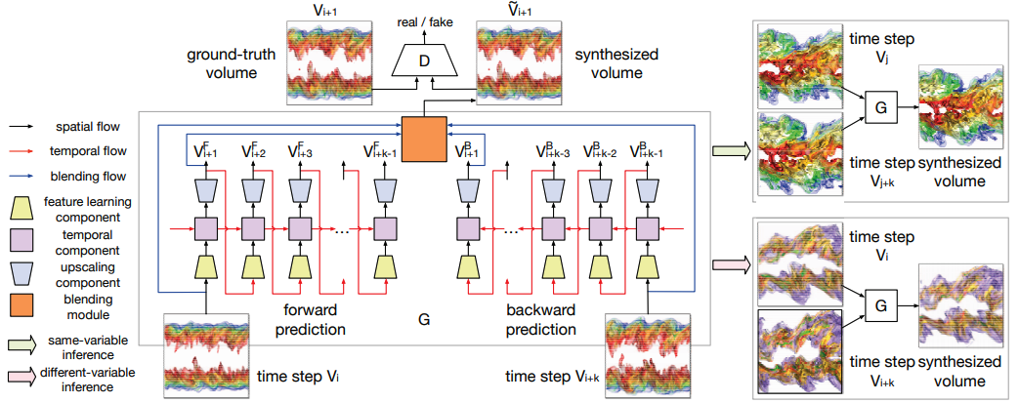
Related work
TSR-TVD: Temporal Super-Resolution for Time-Varying Data Analysis and Visualization
Goal: temporal super-resolution of time-varying data
Method: Recurrent Generative Network (RGN), a combination of RNN and GAN
Notes:
simulation has long sequence, but with storage limit
goal: given low-res time sequence (eg 100 time steps), generate high-res time sequence(e.g. 500 ts)
The generator takes a pair of volumes as input and outputs the synthesized intermediate volume sequence through forward and backward predictions.
Recurrent Generative Network (RGN) temporal super-resolution of time-varying data
RNN for temporal data, GAN for generating images.
The discriminator takes the synthesized intermediate volumes as input and produces a score indicating the realness of the volumes.
residual blocks and ConvLSTM
forward prediction (vi pred vi+1, .., vi+k-1) and backward prediction (Vi+k to pred Vi+k-1 to Vi+1),
blending module to combine results → send to discrimitor: how realness the synthesised volume is
loss: adversarial loss + volumetric loss + feature loss

Slide 16
Volumetric Isosurface Rendering with Deep Learning-Based Super-Resolution
Sebastian Weiss , Mengyu Chu, Nils Thuerey and Rüdiger Westermann
Technical University of Munich

Slide 17
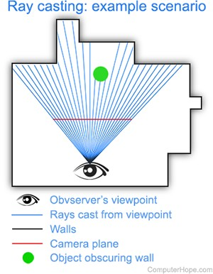
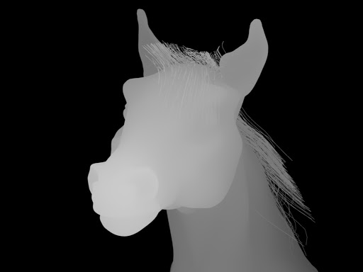
·Ray-Cast
Cast ray from eye to the objects.
Projection plain between eye and objects. → forms depth map.
Ray color determine pixel color. → How to determine ray color?
Notes:
Light emit from light source (sun) reflacted by the objects and get into our eyes.
Reverse this process.

Slide 18
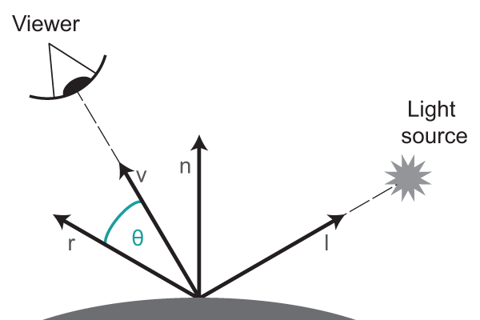
Phong shading
Simulation the real world light effect.
Simplified to 3 factors:
Normal vector → Normal map
Light source position
Eye position → Depth map
color = f(normal, pos_light, pos_eye)

Slide 19
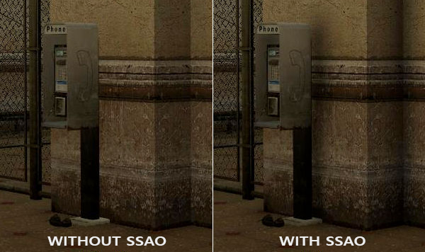
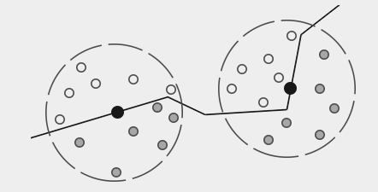
Ambient occlusion
Ambient light
In real world, “crowded” places should be darker than “open” surfaces.
Ambient occlusion is simulating this effect.
AO: expensive
Reason: take surrounding geometry into account
Paper: approximate by low-resolution stored information
Notes:
Global effect

Slide 20
Motivation
isosurface volume ray-casting
A efficient rendering method to render isosurface given a viewpoint
Workload of ray-casting linear in the number of pixels
i.e. Decrease the number of pixels -> decrease workload
Visual quality not satisfactory –> super resolution by deep learning.
Consider global illumination -> increase visual quality
E.g. AO (ambient occlusion)
Problem: calculate AO is time-consuming
AO can be generated from other stored information (eg. depth and normal maps)

Slide 21
Contribution
1. learning the upscaling of a low resolution sampling of an isosurface -> a higher resolution
By reconstruction of spatial detail and shading
Why?
More information; robust to lighting
2. infer AO in the high resolution w/o AO in the low resolution inputs
No need to simulate AO
3. add a motion loss -> maintain frame-to-frame coherence
4. perform a quality evaluation

Slide 22
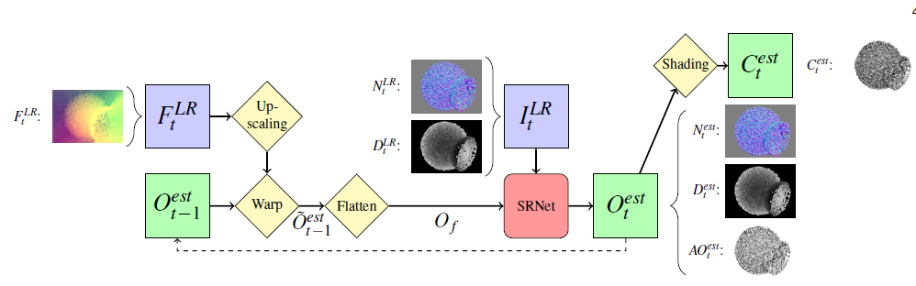
isosurface learning
Blue: low resolution inputs green: high resolution outputs
Yellow: fixed propressing steps Red: trained network
Goal: perform 4x upscaling
i.e. from input images of size HxW to output images of size 4Hx4W
Input: LR depth and normal maps
Output: HR depth and normal maps, additional AO map
screen-space shading used for generating final color

Slide 23
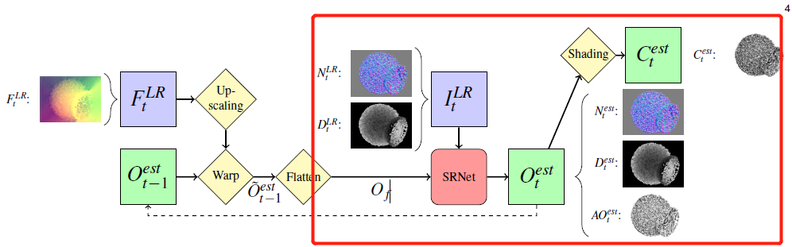
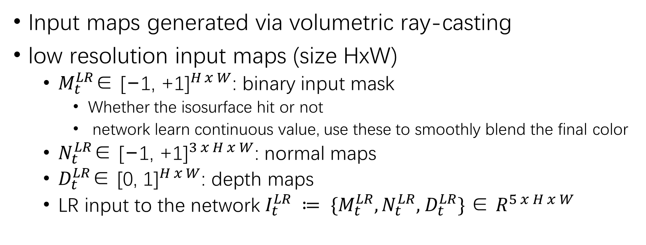
Input data

Slide 24
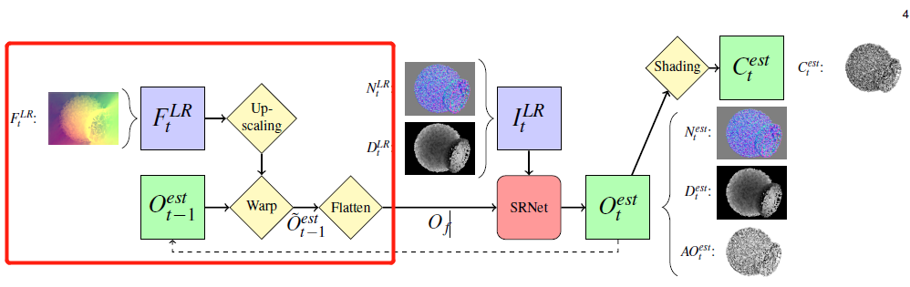
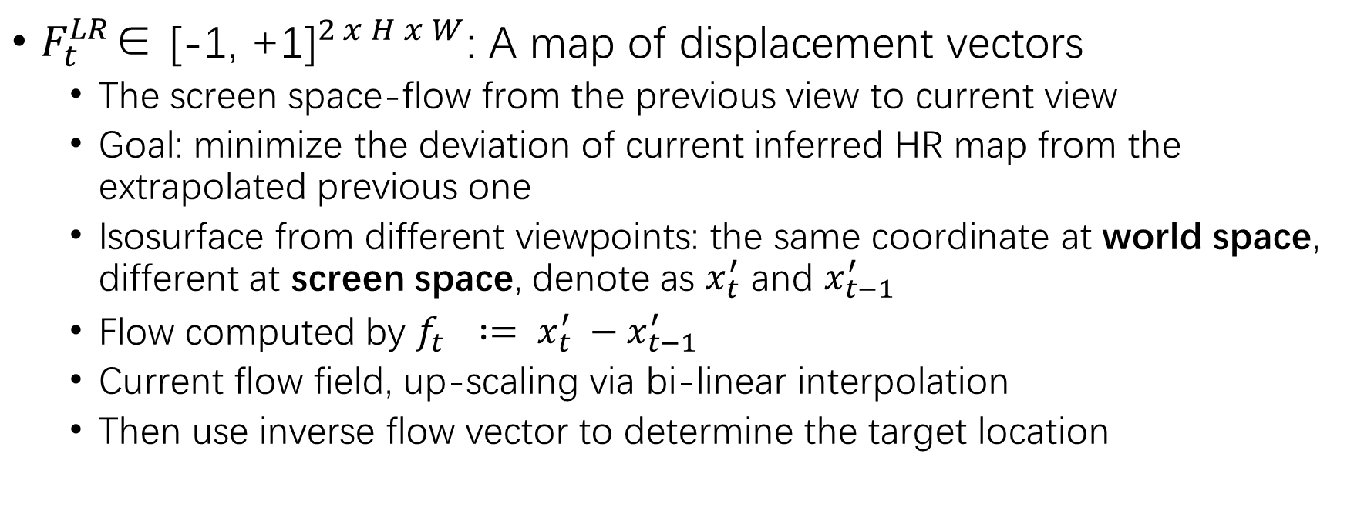
Input data

Slide 25
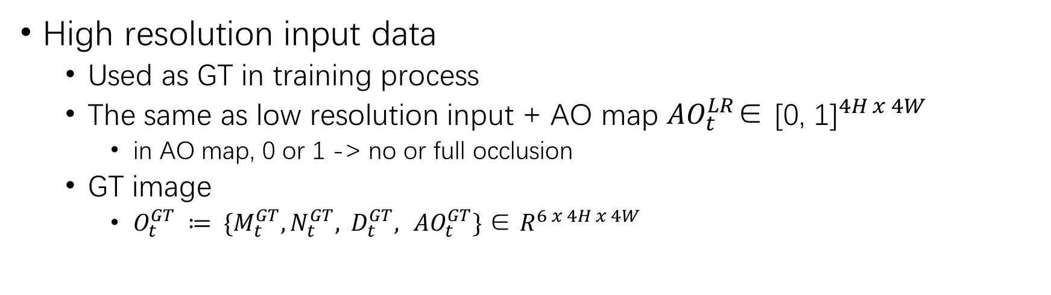
Input data
Notes:
should be 0 - full occlusion 1 - no occlusion

Slide 26
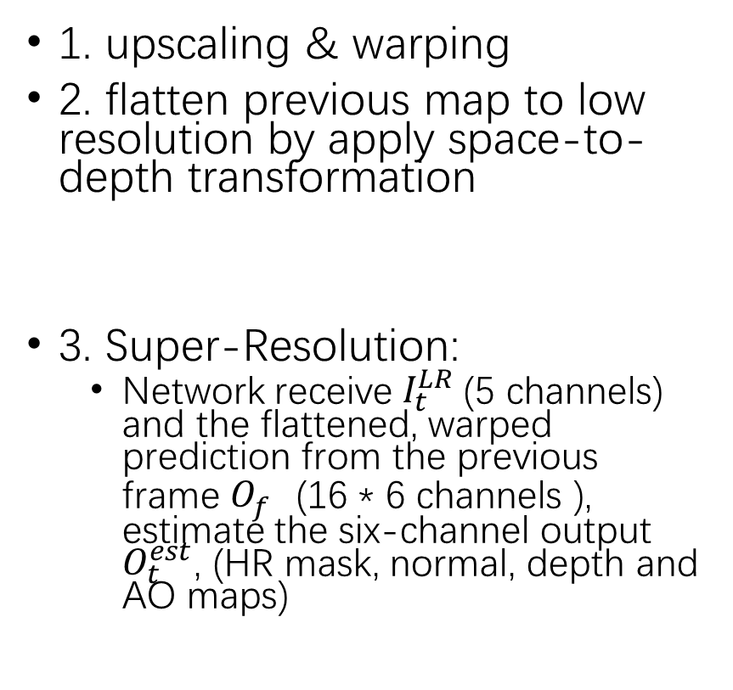
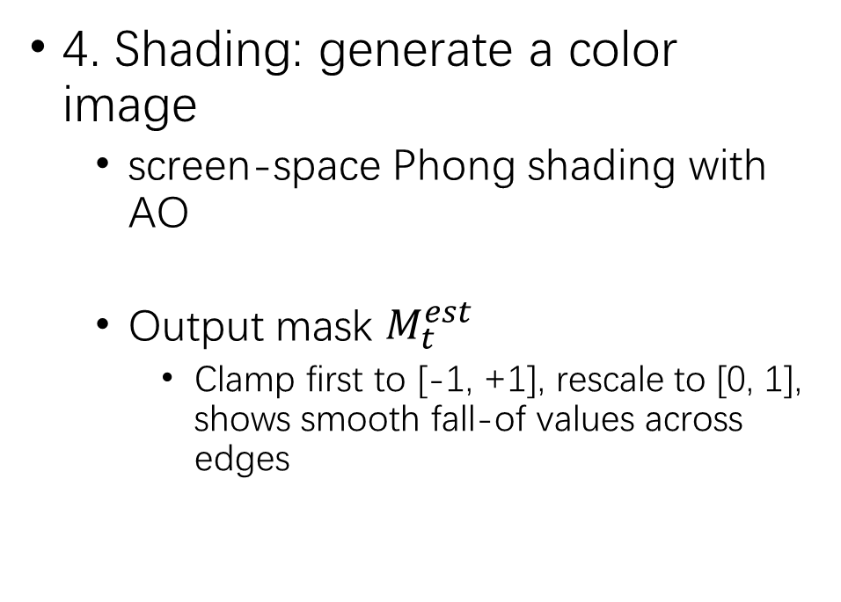
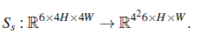
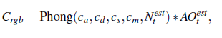
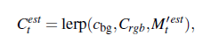
Processing stage
Notes:
the channels of these 4x4 = 16 pixels are concatenated, resulting in a new low resolution image Of with 16-times the number of channels

Slide 27
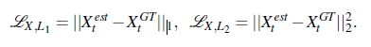
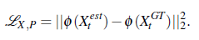
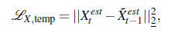
Loss functions
Differentiable Phong shading
Gradient can flow from loss function to update weight of neural networks
VGG on other entries, input transformed first
3. temporal loss
a temporal L2 loss
Penalize differences between current HR and previous warped one
1. Spatial Loss
2. Perceptual loss
detailed outputs instead of smoothed mean values
two images are similar <- have similar activations in the latent space of a pre-trained network
VGG-19 can used on shaded images
Notes:
X be either the mask M, the normal map N, the depth map D, the AO map AO or the shaded output C.

Slide 28
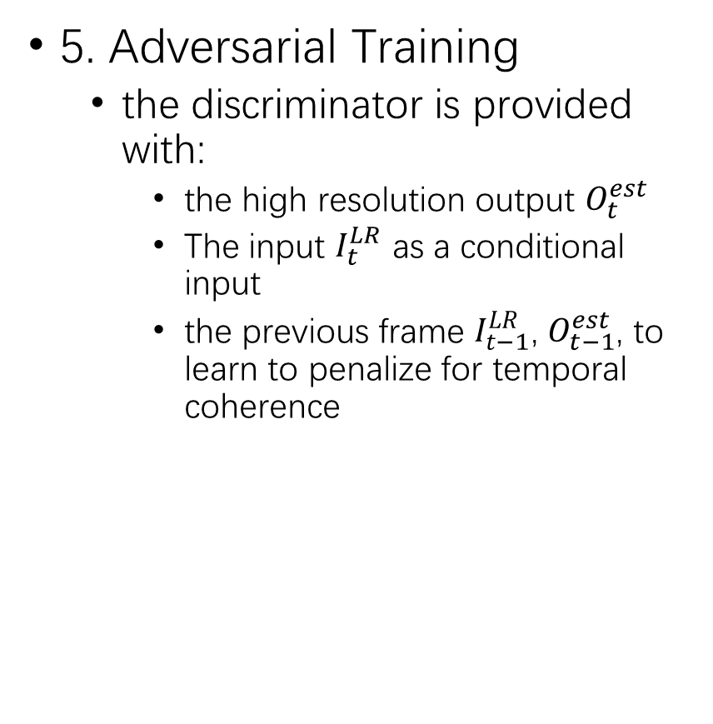
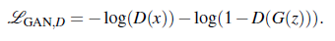
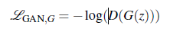
Loss function (cont’d)
4. Loss masking
Pixels where the mask is -1 set to the background color
Area are masked do not contribute to the final result
crucial step simplifies the network’s task: network do not need to match masked areas

Slide 29
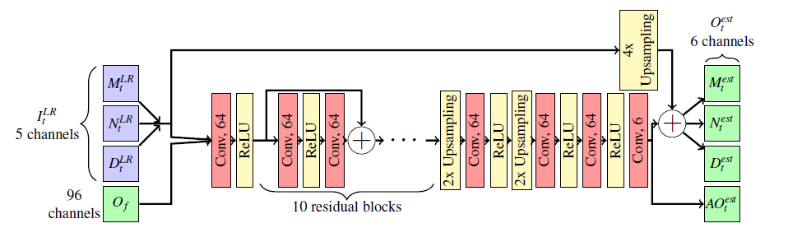
Network architecture
A fully convolutional frame-recurrent neural network (FRVSR-Net) consisting of a series of residual blocks
Notes:
1. one convolutional layer to reduce the 101 input channels (5 from I_LR_t , 6 * 16 from O_f ) into 64 channels
2. 10 residual blocks are used, each of which contains 2 convolutional layers.
3. two upscaling blocks (2 bilinear upscaling, a convolution and a ReLU) arriving at a 4x resolution
4. two convolutions process these channels to reduce the latent feature space to the desired 6 output channels.
All layers use 3x3 kernels with stride 1.
Residual: 5 channels of the input are bi-linearly upsampled and added to the first five channels of the output,
The only exception is Ao_est_t, which is inferred from scratch

Slide 30
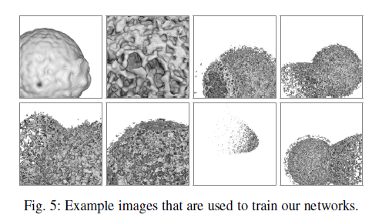
Training data
images of isosurfaces from different timesteps and multi-resolution versions of the Ejecta dataset.
render 500 sequences, each consisting of 10 frames
Each sequence, random select start and end viewpoints
Construct a smooth view path
Get resolution 128x128
Crop sub-regions of 32x32
R: benefit batch processing
Both LR&HR image directed generated by raycaster
Initialize previous frame of 1st frame
Zeroing all entries
Notes:
The smaller spatial size is needed to fit multiple inputs at once into the memory during training and benefit from batch processing in the optimizer

Slide 31
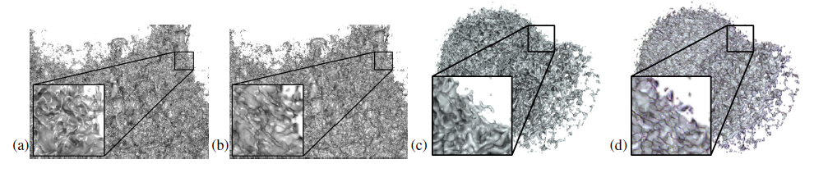
Loss Function Characteristics
geometric surface properties > color images
(a)(c) super-resolution on depth and normal maps with screen-shading
(b)(d) super-resolution on color images
Notes:
leads to superior reconstruction quality

Slide 32
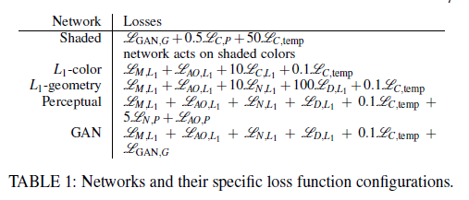
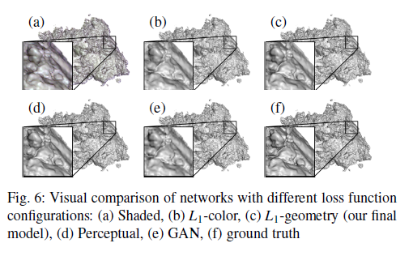
Loss Function Characteristics
Notes:
Receive RGB image and a mask, best results if it utilizes a combination of perceptual and adversarial loss.
color distortions and over-blurring
(b) L1 loss on color images -> deteriorates the quality of the inferred output and produces rather washed out results
(c)(d)(e) “L1-geometry”, “Perceptual’ and “GAN” work with mask, depth, normal and AO in the loss function
-> infer more details
VGG-19 no obvious help, lower the training speed
GAN produces more high-frequent details, decrease the quality of reconstruction
In summary, “L1-geometry” best quality, focus on geometry structure

Slide 33
Question
Loss functions like perceptual loss or GAN loss which works in other problems are not generating good results in the paper. Why do you think this happens? What is a good way to choose loss function?

Slide 34
Qualitative Evaluation

Slide 35
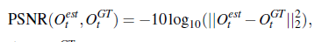
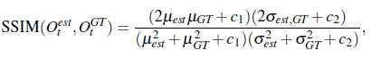
Quantitative Evaluation
peak signal-to-noise ratio (PSNR)
Structural similarity index (SSIM)
SSIM range [0,1], higher means similar
Notes:
Higher -> better

Slide 36
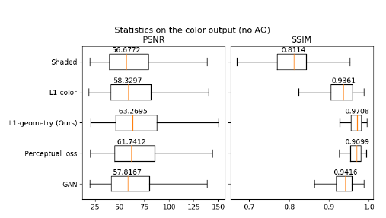
L1 Loss as Loss function

Slide 37
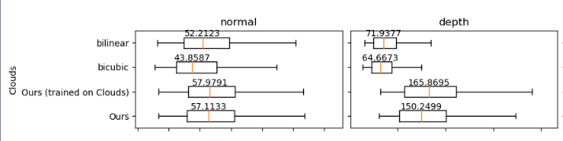
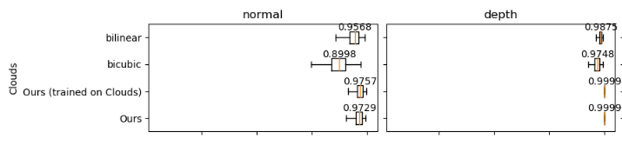
Quantitative Evaluation (Effect of Dataset)
PSNR
Trained on the same data set
Trained on other data set
SSIM
Trained on the same data set
Trained on other data set
Notes:
Interesting results
Model generalize well on unseen datasets.

Slide 38
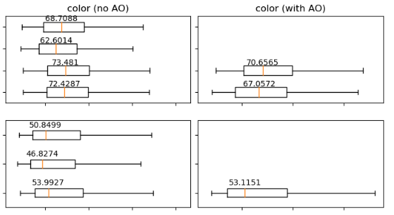
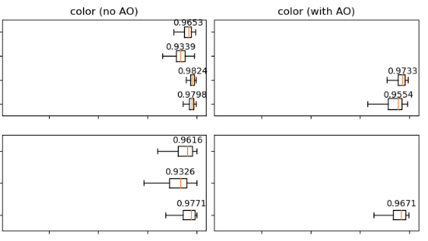
Quantitative Evaluation (AO)
2 Datasets
PSNR
SSIM
Clouds
Ejecta
Question: We can see that error increases when we add AO effect. In possible application of this work, is it beneficial to have estimated AO effect in sacrifice of precision?
Notes:
Reconstruction error increases when output AO

Slide 39
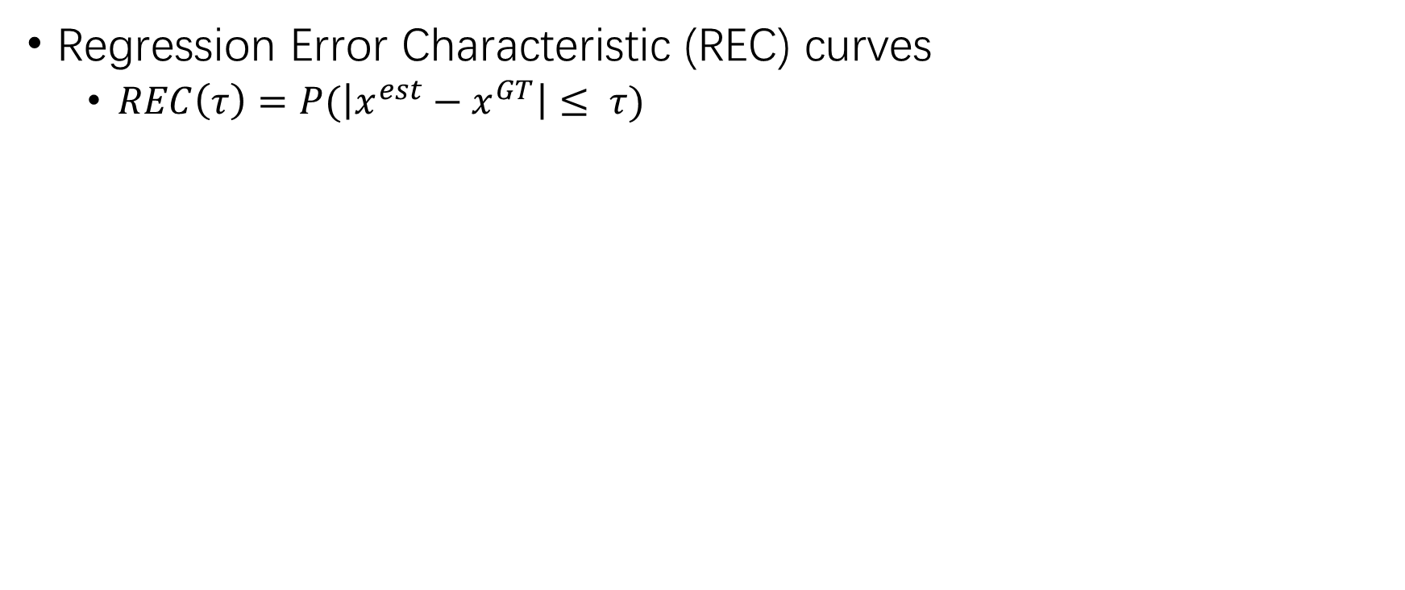
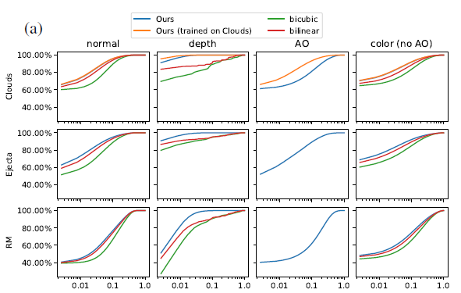
Evaluation

Slide 40
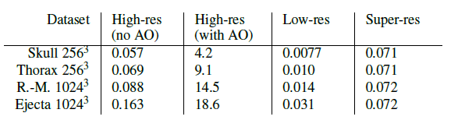
Times for rendering
The timings were performed on a workstation with Nvidia RTX Titan GPU
Notes:
Real time ray casting due to the advance in specialized RTX GPU.
High-res with AO could not be done in realtime but possible in super resolution.

Slide 41
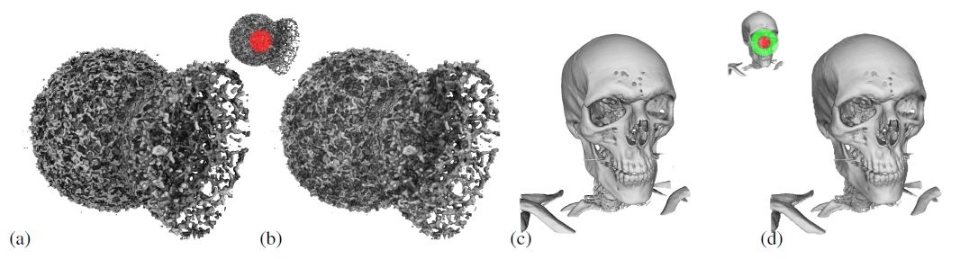
Application (Foveated rendering)
Region of highest acuity → Full Resolution
Other area → Super-Resolution (this method)

Slide 42
Question
Generally speaking, predicting the error of ANN predictions are impossible. How does this influence its application?

Slide 43
Question Summary
The model takes last frame as input, how to deal with the first frame and why?
Why is pretrained VGG-19 possible to work as perceptual loss ?
Loss functions like perceptual loss or GAN loss which works in other problems are not generating good results in the paper. Why do you think this happens? What is a good way to choose loss function?
We can see that error increases when we add AO effect. In possible application of this work, is it beneficial to have estimated AO effect in sacrifice of precision?
Generally speaking, predicting the error of ANN predictions are impossible. How does this influence its application?

